Slide 1
Coop Deployment
Notes:
1

Slide 2
Contents
Current Coop Deployment Structure(Overview)
Coop Security
Coop Global Load Balance(Domain Name)
Coop Site Load Balance(PM2)
Databases Cluster(Replica Set)
Continuous Deployment
Notes:
2

Slide 3
Current Coop Deployment Structure(Overview) – 1
Coop uses node.js as backend;
Coop uses Independent frontend;
Frontend communicate with Backend via API interface;
Conclusion: two ports set, one for backend, one for frontend
Frontend(80)
Backend(3001)
Ajax

Slide 4
Current Coop Deployment Structure(Overview) – 2
Three phases/environment for Web develop && Management
Test
UT(backend verify)
AT(frontend verify)
Manually verify(http://testcoop.china.nsn-net.net)
Development
Developers’ personal setup
http://hzogrvm01.china.nsn-net.net
Production
http://coop.china.nsn-net.net(Old)
https://coop.int.net.nokia.com(New)

Slide 5
Current Coop Deployment Structure(Overview)3 --Mapping
coop.china.nsn-net.net(80) -> coop.int.net.nokia.com(81)
coop.china.nsn-net.net(3000) -> coop.int.net.nokia.com(3001)
coop.int.net.nokia.com(80) –> redirect coop.int.net.nokia.com(443)
coop.int.net.nokia.com(443)/ci/ -> proxy Jenkins
coop.int.net.nokia.com(443)/cpd/falcon/ -> proxy becrtt01(gerrit, http)
coop.int.net.nokia.com(443)/api/v3/projects/ -> proxy becrtt01(gerrit, http)
coop.int.net.nokia.com(443)/ext/api/ -> proxy Coop Backend
…

Slide 6
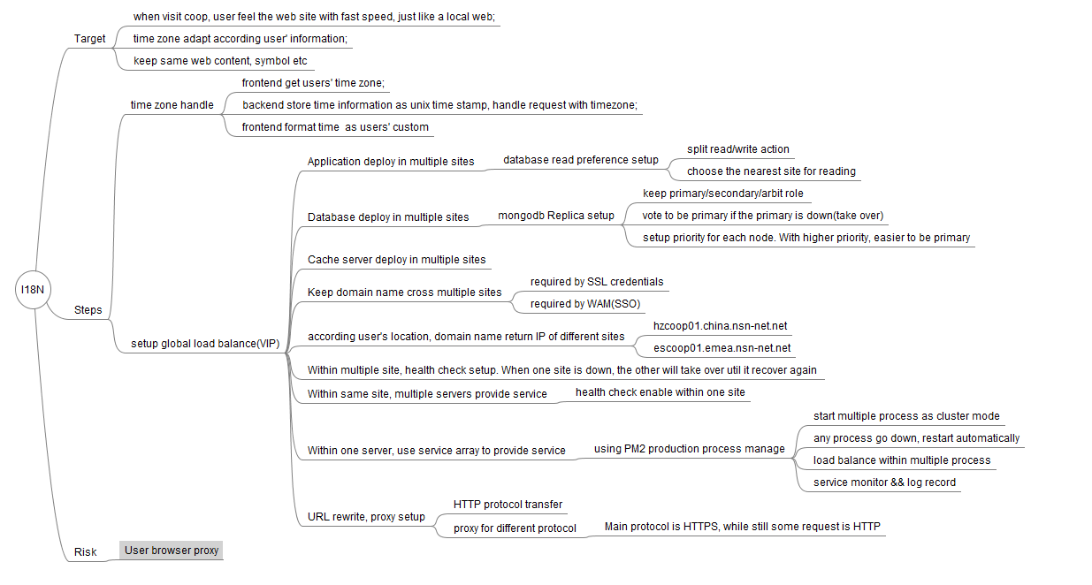
Current Coop Deployment Structure(Overview)4 --Target

Slide 7
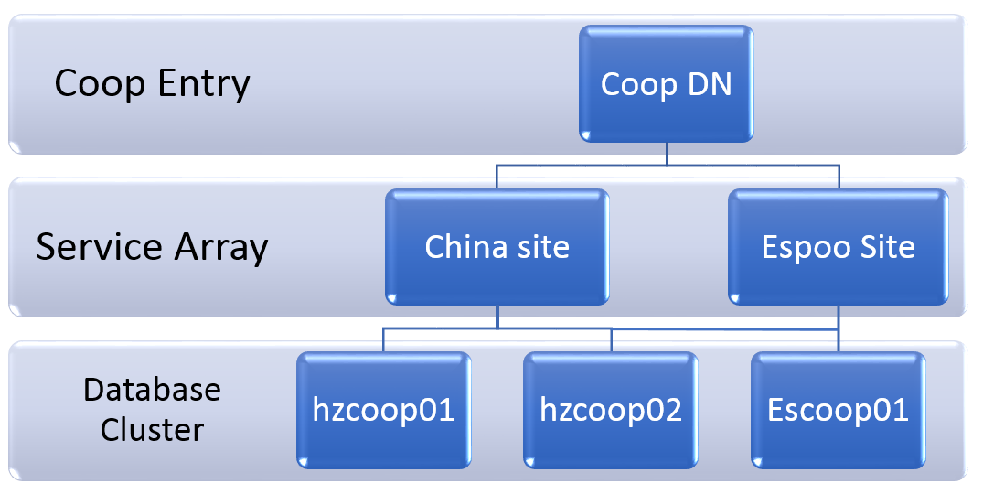
Current Coop Deployment Structure(Overview)5 --Servers

Slide 8
Coop Security
http vs https
Self-sign vs Symantec Sign
https://coop.int.net.nokia.com/
https://testcoop.china.nsn-net.net/

Slide 9
Coop Security -WAM
Web Access Management (WAM) Service provides a centralized and secure infrastructure for managing user authentication and access to Web applications.
It provides a WEB SSO “Single Sign On” capability, which permits a user to enter one username and password in order to access multiple applications. The service eliminates the need for different usernames and passwords, and makes the IT environment more efficient and user friendly.

Slide 10
Coop Security –WAM --continue
With automated authentication (Web SSO), the WAM service authenticates users on behalf of the integrated application. The platform allows the user to gain access to multiple web applications and resources with a single login.
WAM does not manage user accounts and credentials by itself but relies on NSN directory services. Consequently needs a NSN user the NSN Network account username/password, when accessing an application relying on WAM. For external users in NOLS or Central Entitlement, the credentials are managed within the respective process.

Slide 11
Coop Security –WAM --Benefits
Improved end user satisfaction - one login gives access to several applications and reduces the need for additional authentications
Increased productivity - less passwords for end user, reduces help desk calls and increases productivity time
Increased security - centrally managed user life cycle guarantees provisioning and de-provisioning of needed access
Decreased create and operation costs - by using a common shared WAM platform, application development can be faster. Operations can be more efficient by reuse of capacity and knowledge.

Slide 12
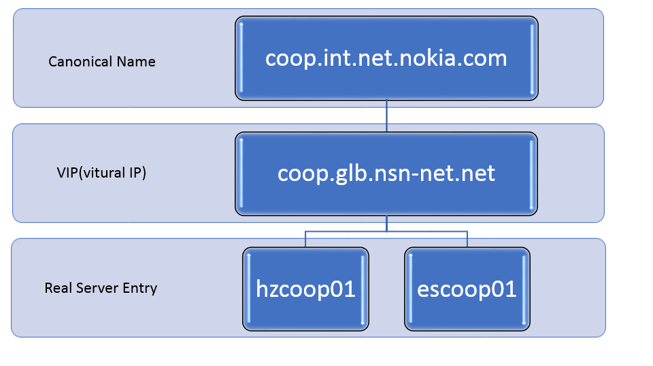
Coop Global Load Balance(Domain Name)
Notes:
12

Slide 13
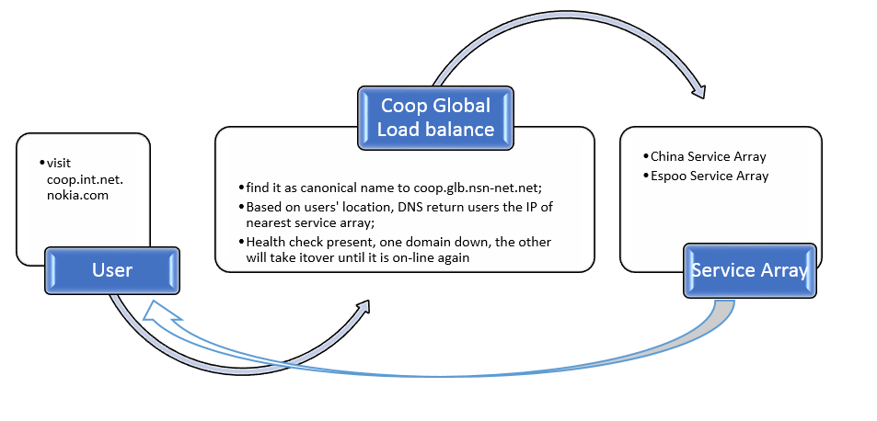
Coop Global Load Balance(Domain Name)
Notes:
13

Slide 14
Domain Name, what?
Provide better service for users, provide service from nearest server;
Enable Health check – the other will take over until it recover again;
Notes:
14

Slide 15
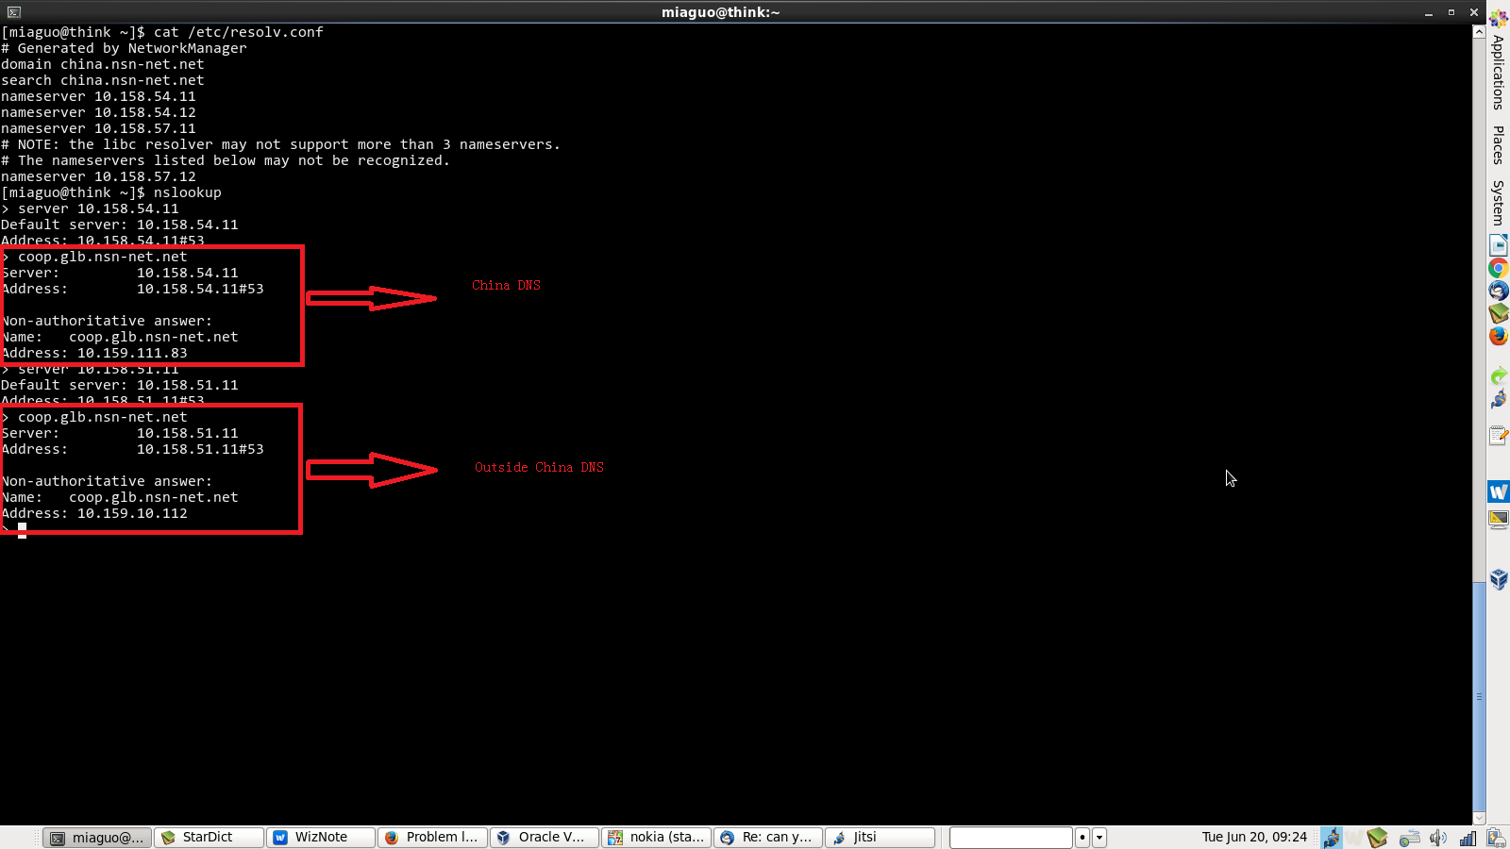
Domain Name, what?
Notes:
15

Slide 16
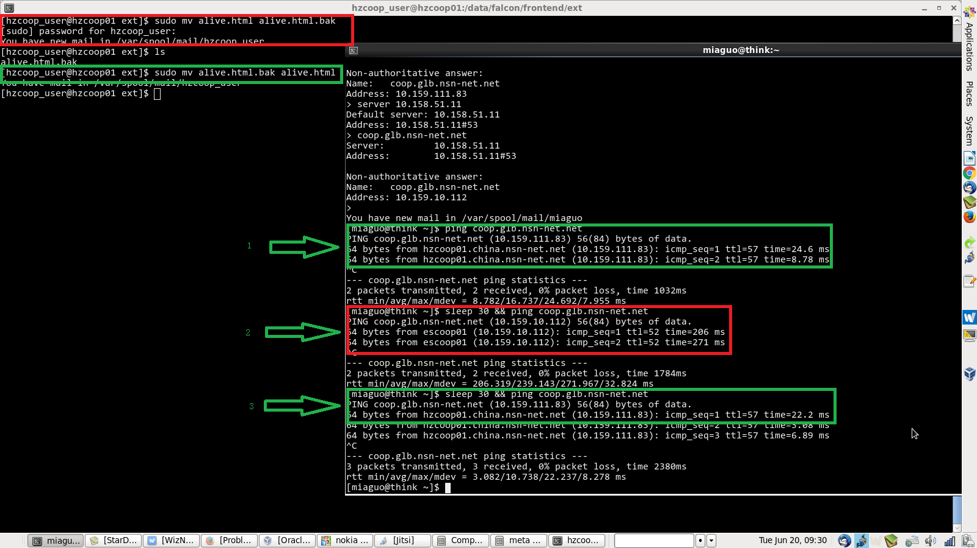
Domain Name, what?
Notes:
16

Slide 17
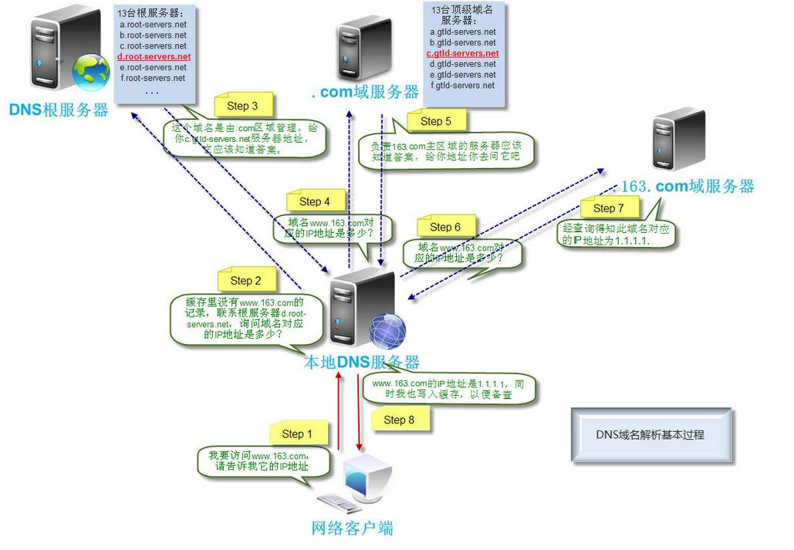
Domain Name, How?
Notes:
17

Slide 18
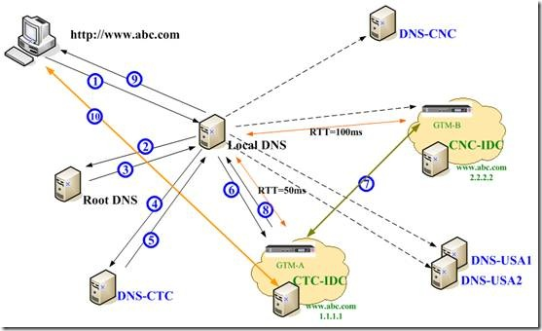
Domain Name, How? – Global Load Balance
Notes:
18

Slide 19
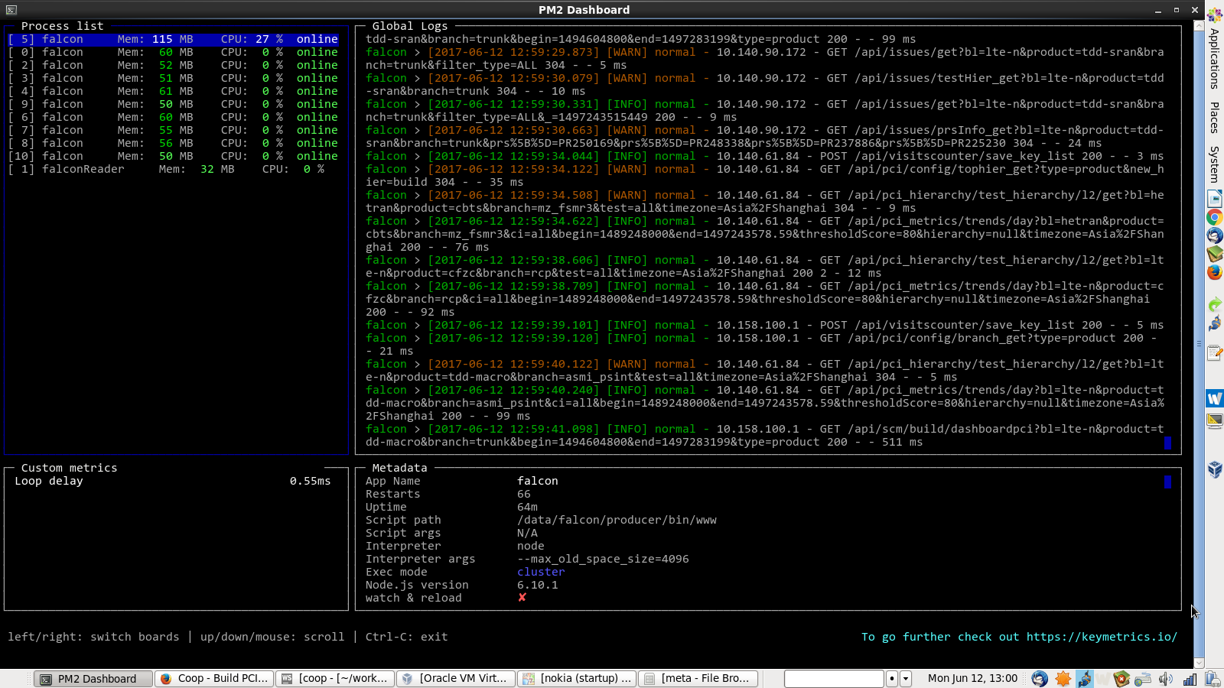
Goop Site Load Balance
xxx Project Plan / V0.1 / 2016-01-22
Notes:
19

Slide 20
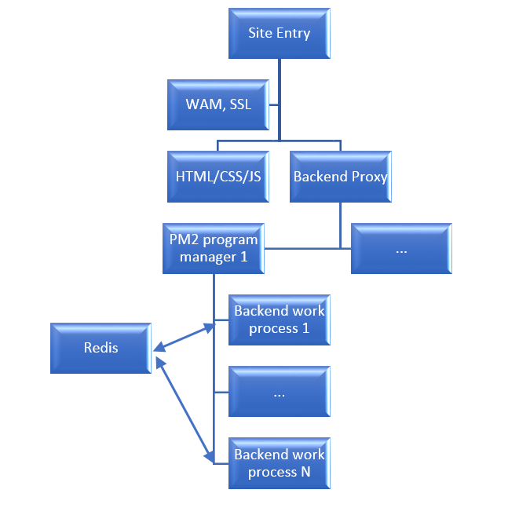
Goop Site Load Balance
xxx Project Plan / V0.1 / 2016-01-22
Notes:
20

Slide 21
Databases Cluster(Replica Set)
Database: MongoDB
Mode: Replica Set
Target:
Improve redundancy, automate failover;
Databases load balance within members
Speed up read speed;
Notes:
21

Slide 22
Databases Cluster(Replica Set) -- why not Master – Slave
Why not Master – Slave mode
Mongo deprecates the use of master-slave replication for components of sharded clusters.
master-slave replication provides less redundancy and does not automate failover
Notes:
22

Slide 23
Replica Cluster
Database: MongoDB
Mode: Replica Set
Target:
Improve redundancy, automate failover;
Databases load balance within members
Speed up read speed;
Notes:
23

Slide 24
Databases Cluster(Replica Set)
Primary.
The primary receives all write operations.
Secondaries.
Secondaries replicate operations from the primary to maintain an identical data set. Secondaries may have additional configurations for special usage profiles. For example, secondaries may be non-voting or priority 0.
Arbiter(vote only)
Notes:
24

Slide 25
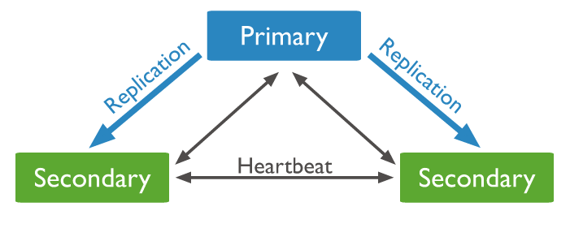
Databases Cluster(Replica Set) 1 primary + 2 secondary

Slide 26
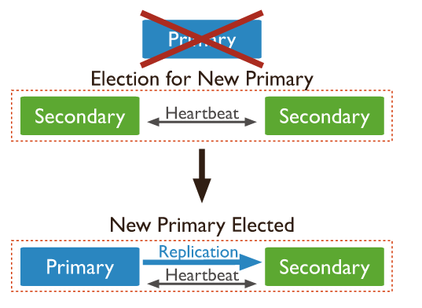
Databases Cluster(Replica Set) --Elections

Slide 27
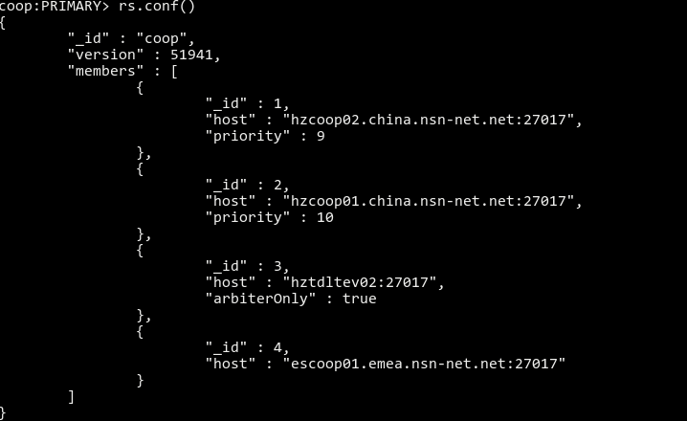
Databases Cluster(Replica Set) --Elections

Slide 28
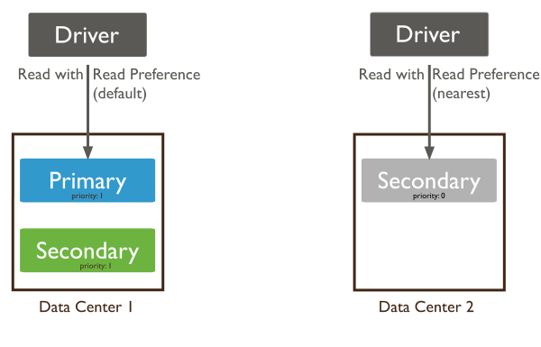
Databases Cluster(Replica Set) –Read Preference

Slide 29
Continuous Deployment
“Every software development team should have a fully automated deployment process.” It’s not even a debate. It’s a declaration.
In actual fact there are only a small percentage of software development teams who have a ‘one-click’, totally hands-off, fully automated deployment process. Many teams have a partially manual deployment process and most have an entirely manual process.
Notes:
29

Slide 30
Continuous Deployment – why aren’t you doing it?
“Setting-up automated deployment will take forever! It’ll steal time from developing the actual software my team has been assembled to create!”
“Our deployment process has so many moving parts, how do I even begin to automate it?”
“It’ll just drain energy from our developers – who would rather be solving business problems and not writing scripts to copy files across a network.”
Notes:
30

Slide 31
Continuous Deployment – Benefit
#1: Deployments become much less error-prone and much more repeatable
#2: Anyone in the team can deploy software
#3: Engineers spend their time developing software
#4: Deploying to somewhere new is not a headache
#5: You can release more frequently
Notes:
31

